Slide 1


Branch Office Caching Services 6.5 with Content Server 6.5
Harry Dedrickson Sept 21 2010

Slide 2
Agenda
BOCS Product Overview and Capabilities
BOCS and Support Applications.
Installation Requirements
Deployment Scenarios
Required personnel needed for installations
Configuration Steps.
Tuning
Troubleshooting
Live Demo !

Slide 3
BOCS
Branch Office Caching Services (BOCS) is a lightweight server product running in the JBoss servlet container. Use BOCS servers to give users on WDK-based clients the fastest possible access to frequently used content without the requirement to install and maintain a remote Content Server and distributed storage area at a remote site. BOCS servers are best used at sites distant from the primary Content Server and any remote Content Servers.
BOCS serves content files to WDK-based client applications from a local content cache. The content is cached when users request the content, but may also be cached, programmatically or through a administration job, prior to user requests. Users can also save content to the repository through a BOCS server. Depending on the underlying client application, writing content to a repository from a BOCS server can be either synchronous or asynchronous.
BOCS servers communicate only with ACS servers and DMS servers. They do not interact with Content Servers or a repository’s supporting database. BOCS servers use the HTTP or HTTPS protocol to serve content.

Slide 4
BOCS Capabilties
Content Transfers impacting user experience
Customers want to move off our Distributed architecture
and move to simplified , unified content management systems
With reduced administration and overhead.
Customers want a pre emptive methodology to handle future get
Content requests
Customers with high latency networks can still continue
Working.
Encryption is offered as a way to secure content on remote BOCS servers
BOCS allows the customer to grow the Documentum Enterprise as new
Offices are regional centers are brought online while still maintaining 24/7 Coverage.

Slide 5
BOCS Capabilities, 3 kinds of caching.
BOCS can park content or store content locally before it is uploaded
So users can continue working on large content files and share that content
within the organization.
BOCS caches imported content or content already stored in docbase via a checkout.
BOCS can cache content preemptively with BOCS job via Documentum Administrator Content is Copied with folder based DQL query with predicate.

Slide 6
BOCS w/supporting Applications
Configured ACS Server comes with Content Server
Installed, Running and Configured DMS Server
Installed, Running and Configured WDK which is BOCS aware
Installed, running and Configured BOCS server

Slide 7
Installation Requirements
All systems must be in DNS
Separate domains needed if regional testing is simulated. i.e. multiple network location objects
VMware is supported Fixed IP recommended
DHCP will work.
DMS can be installed on Content Server
But it is recommended on separate system
BOCS systems should be on separate system
Branch Office Caching Services write mode is not supported with Content Server
5.3 SPx or Documentum Administrator 5.3 SPx.

Slide 8
BOCS Deployment Scenario
Content Server/ ACS Server
Global Registry
WDK App Server
Network Location Corp
DMS Server
BOCS Server
Corp
Firewall
BOCS Server
Remote Office
WDK App Server
Network Location
Remote Office

Slide 9
Required personnel needed for installations
Senior Docbase Administrator
Network Administrator
Security Administrator if Firewalls are present
Web Application Administrator if Jboss SSL is enabled
SSL is enabled via changing http to https , no other
DCTM steps are required, we not assist in configuring Jboss to SSL.

Slide 10
Installation and Configuration Steps
Step 1) Environment and Network Resources
Select domains targeted for network location at least two should be indentified.
Inform network administrator of DNS requirements for Content Server
DMS Server , BOCS Server and WDK Application Server.
If SSL desired for Jboss, inform Web Administrator that SSL will be needed
Inform the Firewall Administrator the hosts\ports that needed for each server
*********************************************************************
Step 2) Docbase Creation and ACS validation:
Install a Content Server which is BOF enabled, make sure JBOSS is functioning and ACS Servlet is deployed. Check acs.properties file , located:
C:\Documentum\jboss4.2.0\server\DctmServer_MethodServer\deploy\acs.ear\APP-INF\classes\config
ACS.properties provides docbase connection information and tuning options.

Slide 11
Installation and Configuration Steps
Installation and Configuration Steps
Step 3) ACS Server ACS Properties What to set and why
NOTE: If BOCS is not set in pull mode , SSL is not set and firewalls are not used the acs.properties file can be used as is, with out modification. File gets appended when new docbase are added. All docbases must be up when ACS is started
#Startup mode for ACS/BOCS servlet
mode.cachestoreonly=false Tells the servlet to run as : "false = ACS true = BOCS"
# BOCS Tuning
bocs.pulling.interval=10 How often BOCS polls DMS when pull mode is set.
primary.content.store.quota=1000M Max value for parked content for BOCS "K" "M" "G"
bocs.keystore= Private key path when BOCS is set in pull mode
primary.content.store.root=C\:\\Documentum\\acsCache Path for Parked Content
# Docbase Connection Information
repository.name=vmcswin65sql.vmcswin65sql server config value + docbase name
repository.login=dmadmin docbase owner
repository.password= default is blank since anonymous login is used, ACS only
repository.acsconfig=VMCSWIN65SQLACS1 ACS config object name

Slide 12
Installation and Configuration Steps
Step 3) ACS Server ACS Properties What to set and why cont.
# Cache Location
acs.cache.enabled=true Turns on ACS caching default is false
cache.store.root=C\:\\Documentum\acsCache Root directory for acs cache when enabled
cache.store.quota=1000M Max value for parked content for ACS "K" "M" "G“
# Java and JMS specifics
java.naming.factory.url.pkgs=org.jboss.naming\:org.jnp.interfaces JNDI entry for JMS naming factory
jms.connection.factory=/MethodServerQueueConnectionFactory JNDI entry for JMS connection factory
jms.url=jnp\://VMCSWIN65SQL\:9084 URL for BOCS/ACS to access JMS
jms.queue.name=/queue/null JNDI entry for JMS queue
jndi.factory=org.jnp.interfaces.NamingContextFactory JNDI entry for JMS naming contect factory
# Tuning parameters
proxy.port= Port when proxy is configured for ACS/BOCS
policy=Throttle,1,10,0 First Value "1" this policy active on first connect to server
Second value "10" Ten connections client our set
Third Value "0" Number of connections taken from
other clients
policy.1=ReplaceRequest,50,1 First Value "50" Number of active threads when policy is active
Second Value "1" Number of threads per client for this policy

Slide 13
Installation and Configuration Steps
Step 3) ACS Server ACS Properties What to set and why cont
# Tuning parameters cont.
proxy.host= Set this value when web proxies are configured
dms.pulling.url= Tells BOCS where to reach DMS when pull mode is set
bocs.configuration.name= Set this value when BOCS is set to pull mode.
bocs.pulling.mode.enabled= Sets BOCS to Pull Mode default is false.
# Tracing and debug
tracing.enabled=false Turns on tracing for ACS servlet default is false
mode.debug=false Turns on debug mode ACS servlet default is false

Slide 14
Installation and Configuration Steps
Step 4) PRE Installation Steps ( DMS small installation footprint)
Decide if DMS will be stand alone or installed with Content Server. Installing with the Content Server allows you to leverage environment variables and simplifies overall administration of the entire enterprise. Only one DMS server is permitted for each enterprise, failover is not supported and embedded ASA10 cannot be substituted.
• If you do not want to accept the defaults for directory locations or port numbers, have the chosen directories and port numbers available.
Default directory locations are suggested for the installation directory, the user directory, and the directory in which JMS messages are stored.
Default port numbers are suggested for the connection broker (1489 for a native connection and 1490 for an SSL connection), application server instances (8489 for instance server), and the database server (2638).
• A password for the dmsAdmin user is chosen.
The dmsAdmin user administers the DMS server’s dms.properties file through the
resource agent in Documentum Administrator.
• The DOCUMENTUM and DOCUMENTUM_SHARED environment variables are set.
Set $DOCUMENTUM to the installation directory. The installation owner must have read, write, and execute permissions on this directory and its subdirectories.
Set $DOCUMENTUM_SHARED to the directory in which you want to install DFC on the DMS host. This is also the top‑level directory under which the scripts used to uninstall the components are stored.

Slide 15
Installation and Configuration Steps
Step 4a) Install DMS
DMS Installation Steps documented in Content Server installation guide See page 110 for 6.5. Basically a pick and click
set of steps. During installation good idea to note the URLS and port number for DMS, make sure to record the dmsAdmin user account password along with sysbase admin password. Make sure is in DNS if installed on a separate host.
Post Installation Steps.
Using Documentum Administrator, create a configuration object for DMS in the global registry. Use the instructions in the online help for Documentum Administrator.
Optionally, create the resource agent for DMS in Documentum Administrator.
The DMS resource agent enables you to edit the dms.properties file to reset the expired message cleanup interval. You will need the URL created during installation to enable the agent
The Documentum Administrator online help or the Documentum Administrator User Guide provide instructions on creating a resource agent.
The post URL dialog box appears.
Note the information that appears in the post URL dialog box. If you plan on creating repository objects for DMS, you will need this information. The post URL is used to contact the DMS to deliver messages from DFC to DMS.

Slide 16
Installation and Configuration Steps
Step 4b) Starting and Stopping DMS
Windows: Use the Service Manager to start the “Docmentum Messaging Server”
UNIX : Use the following procedures to start and stop DMS on UNIX and Linux hosts.
To start DMS:
1. Navigate to $DOCUMENTUM_SHARED/dms.
2. Run startDatabase.sh.
3. Navigate to $DOCUMENTUM_SHARED/jboss4.2.0/domains/DctmDomain.
4. Run startMethodServer.sh.
5. Run startDMS.sh.
Stop the application server after stopping DMS.
To stop DMS:
1. Navigate to $DOCUMENTUM_SHARED/jboss4.2.0/domains/DctmDomain.
2. Run stopDMS.sh.
3. Navigate to $DOCUMENTUM_SHARED/jboss4.2.0/domains/DctmDomain/bin.
4. Run stopMethodServer.sh.
5. Navigate to $DOCUMENTUM_SHARED/dms.
6. Run stopDatabase.sh.

Slide 17
Installation and Configuration Steps
Step 4c) dms.properties control message lengths, polling schedules and
Message cleanup
File is automatically updated and there is no is need to edit any of the parameters unless requested by engineering . See dmsfull.propertiies for complete description of all the values.
dms.jdbc.data.source.name=java\:/jndi/dmsASA
dms.jdbc.message.body.max.length=32767
dms.jdbc.destination.error.max.length=32767
dms.jdbc.message.id.batch.size=20
dms.jdbc.object.prefix=dms.DBA.
dms.jndi.factory.name=org.jnp.interfaces.NamingContextFactory
dms.jndi.url=jnp\://VMCSWIN65SQL\:8493
java.naming.factory.url.pkgs=org.jboss.naming:org.jnp.interfaces
dms.jms.connection.factory.name=/DMSQueueConnectionFactory
dms.jms.module.name=dms-jms
dms.push.queue=queue/push
dms.push.retry=queue/pushRetry
dms.service.return.url=http://VMCSWIN65SQL:8489/

Slide 18
Installation and Configuration Steps
Step 4c) dms.properties control message lengths, polling schedules and
Message cleanup cont.
# time in seconds
dms.destination.unavailable.interval=60
dms.schedule.pool.size=5
dms.push.task.count=1
# time in seconds
dms.schedule.start.time=1
# time in seconds
dms.schedule.interval=60
# time in seconds
dms.push.sleep.time=60
# time unit in day
dms.cleanup.schedule.interval=1
# time unit in day
dms.cleanup.period=180

Slide 19
Installation and Configuration Steps
Step 5) Install BOCS Server
Select a location to serve your remote users.
Make sure host will be in DNS.
Take some to time evaluate correct storage resources, many customers run out of disk space because they under estimate how much caching they want the BOCS server to support.
BOCS installations can be combined with Application Servers /WDK clients not recommended for production. For testing purposes its completely compatible.
Installation is pick and click, note URLS , port numbers , and bocsAdmin password
For DBA database admin do not use ! or % characters, alpha numeric passwords only, Sybase Bug.

Slide 20
Installation and Configuration Steps
Step 5a ) BOCS Server Installation, Review acs.properties file
mode.cachestoreonly=true True means the servlet will run as BOCS service
tracing.enabled=true
mode.debug=true
#Added for jboss
jndi.factory=org.jnp.interfaces.NamingContextFactory
jms.url=jnp\://PLEMADMAX\:8090
java.naming.factory.url.pkgs=org.jboss.naming\:org.jnp.interfaces
jms.connection.factory=/BOCSQueueConnectionFactory
jms.queue.name=/queue/bocsQueue
bocs.keystore=E\:/Documentum/bocs/config/bocs.keystore
bocs.configuration.name=
bocs.pulling.mode.enabled=FALSE
dms.pulling.url=
bocs.pulling.interval=10
encryption.mode=require
proxy.host=
proxy.port=
policy=Throttle,1,10,0
cache.store.root=E\:\\Documentum\\acsCache Cache path i.e. checkout, import, precache content
cache.store.quota=1000M Max Size for acscache, 1000m = 1GB
primary.content.store.root=E\:\\Documentum\\primeStore PrimeStore path for parked content
primary.content.store.quota=1000M Max Size for primeStore, 1000m = 1GB

Slide 21
Installation and Configuration Steps
Step 5a ) BOCS Server Installation, Review acs.properties file
BOCS specific parameters.
mode.cachestoreonly=false alse means it will start as BOCs servlet
cache.store.quota= max size for acs cache
cache.schedule.housekeeper = 24*3600 how often housekeeper will run to clean up cache , seconds
cache.schedule.housekeeper.start_delay = 5*60 Delay before first house keeper gets launched , seconds
cache.schedule.housekeeper.retire_interval = 30*24*3600 Interval since last access before files considered obsolete, seconds, month
cache.schedule.consistency=24*3600 how often consistency of cache is validated seconds, default once a day
cache.schedule.flush_directory = 5*60 How often cached information is flushed from hard drive, seconds
repository.validation.delta = 360 Time period between moment URL content retrieval was generated until it is still considered valid, minutes , default is 6 hours
validate.certificate = false BOCS will validate public key certficate, default is false.
primary.content.store.root=R:\PrimeContent Root directory for primeStore content ( parked content only)
primary.content.store.quota= maximum size for storage of parked content “K” ,”M”, ”G”
primary.content.store.cleanup.interval=3600*24 max value parked content can stay before storing in Content Store, 24 Hours
bocs.pulling.mode.enabled=false Tells BOCS to work in pull mode.
dms.pulling.url= URL that BOCs uses in pull mode to access DMS server.
bocs.configuration.name= BOCS name in the global registry when BOCS is setup in pull mode.
bocs.max.number.pull.messages max value for number of messages can accept in one request in pull mode
proxy.host= proxy host when BOCS/ACS works thru a proxy
proxy.port= proxy port used BOCS/ACS
queue.predictive_caching.schedule Time interval when content to be precached should be read from
=HH:MM-HH:MM,HH:MM-HH:MM ACS , when not configured content can be pre-cached immediately
when a message comes.

Slide 22
Installation and Configuration Steps
Step 5a ) BOCS Server Installation, Review acs.properties file
queue.distributed_write_store.schedule defines time intervals when content should be uploaded to ACS
=HH:MM-HH:MM,HH:MM-HH:MM when schedule not defined, content can be uploaded to ACS immediately
when message comes.
optimal.chunk.size=49152 Chunk size bytes used by BOCS during upload content to ACS 49152
cache.schedule.consistency.start.delay=600 Initial delay before the first consistency check is performed in sec 600
request.timeout.interval=10000 Max wait time during content upload when connection lost 10000 milliseconds
content.segment.size=131072 default content segment size in bytes incremental function only when BOCS
creates the content

Slide 23
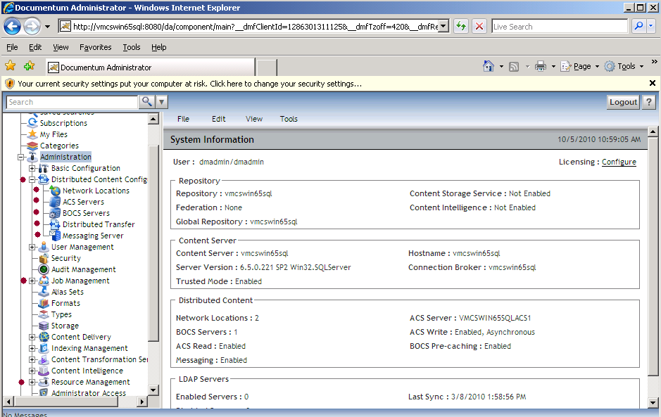
Configuration Steps
Using Documentum Administrator to finish configuration

Slide 24
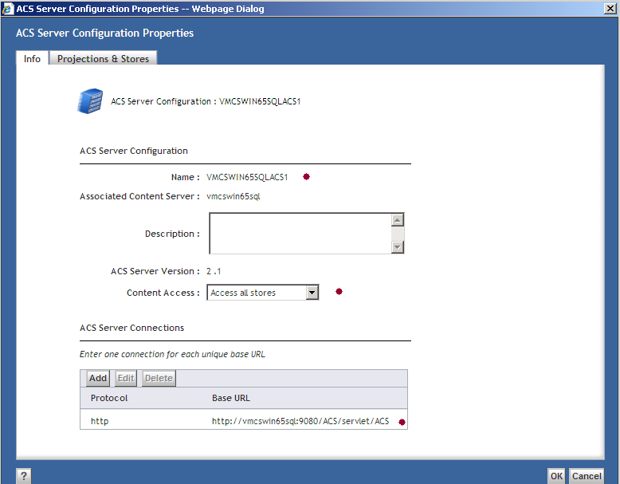
Configuration Steps
Using Documentum Administrator to finish configuration
Installation and Configuration Steps

Slide 25
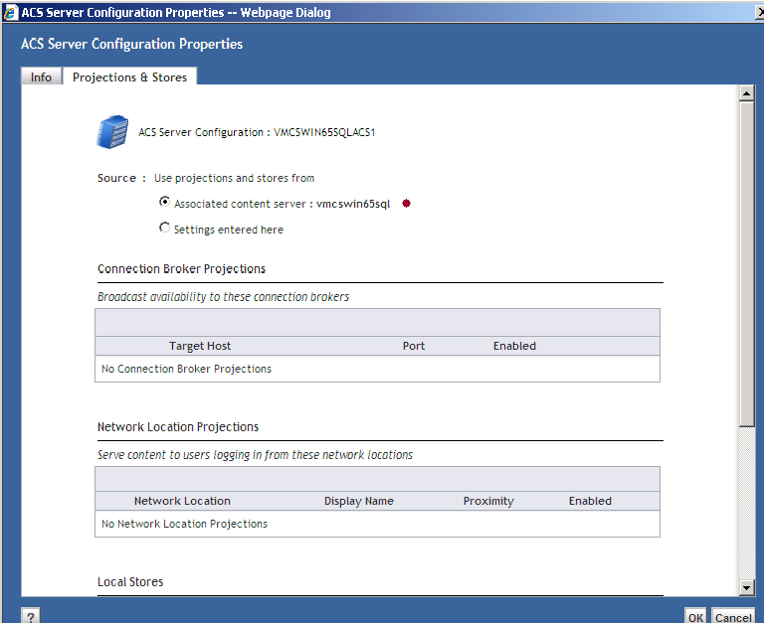
Configuration Steps
Using Documentum Administrator to finish configuration
Installation and Configuration Steps
Installation and Configuration Steps

Slide 26
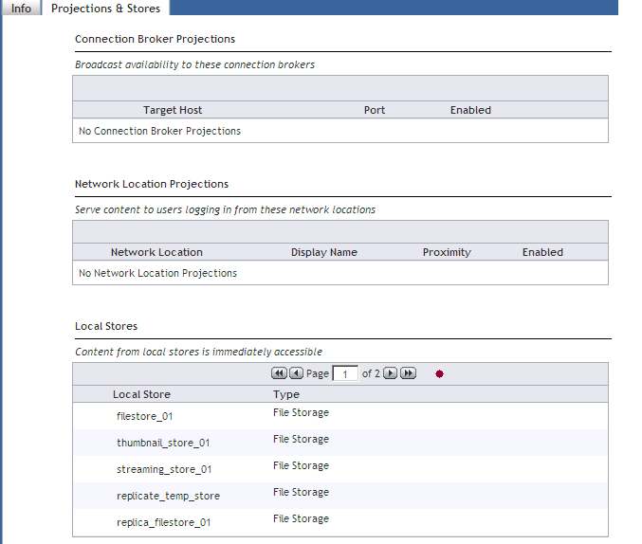
Configuration Steps
Using Documentum Administrator to finish configuration
Installation and Configuration Steps
Installation and Configuration Steps

Slide 27
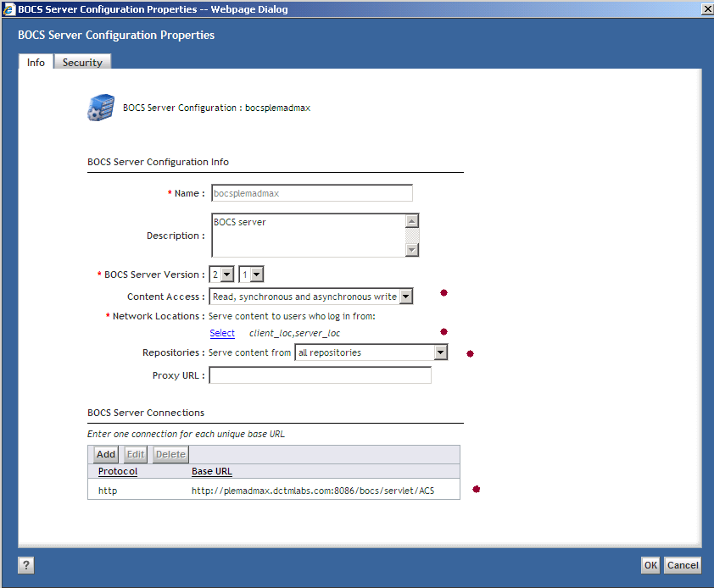
Configuration Steps
Using Documentum Administrator to finish configuration
Installation and Configuration Steps
Installation and Configuration Steps

Slide 28
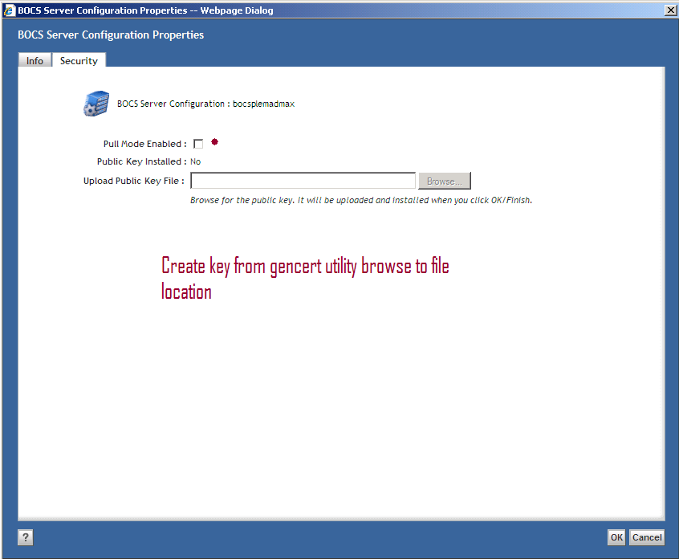
Configuration Steps
Using Documentum Administrator to finish configuration
Installation and Configuration Steps
Installation and Configuration Steps

Slide 29
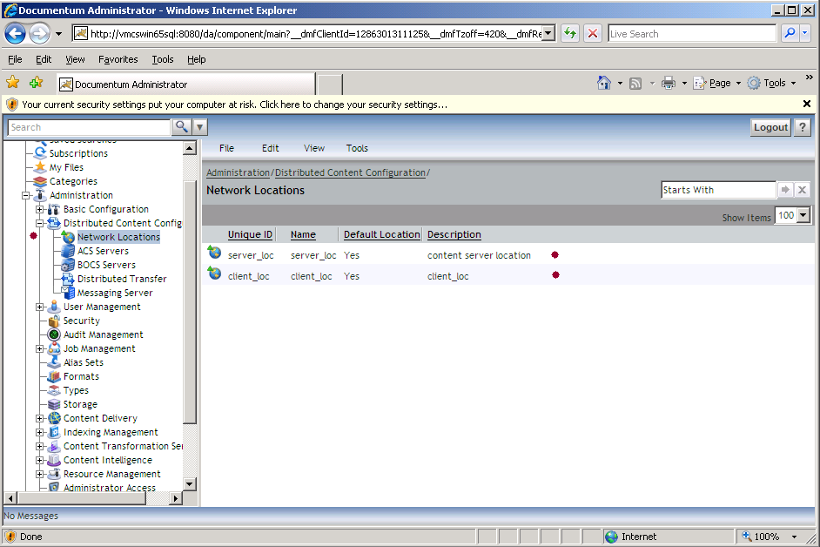
Configuration Steps
Using Documentum Administrator to finish configuration
Installation and Configuration Steps
Installation and Configuration Steps

Slide 30
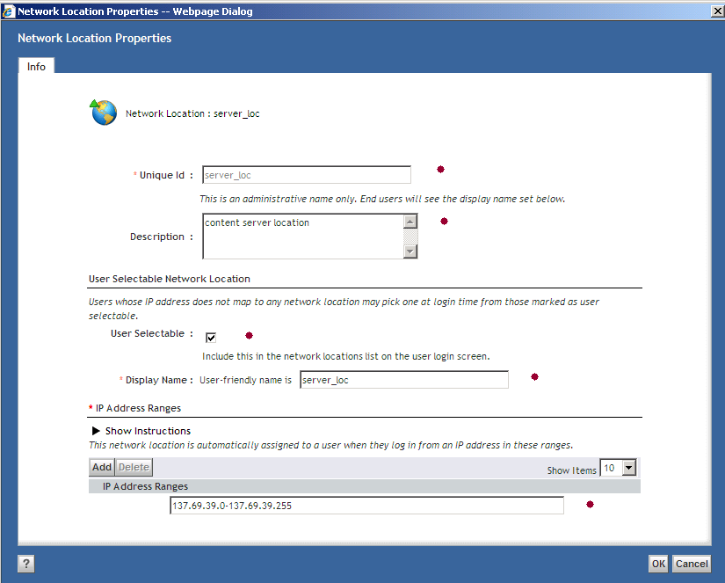
Configuration Steps
Using Documentum Administrator to finish configuration
Installation and Configuration Steps
Installation and Configuration Steps

Slide 31
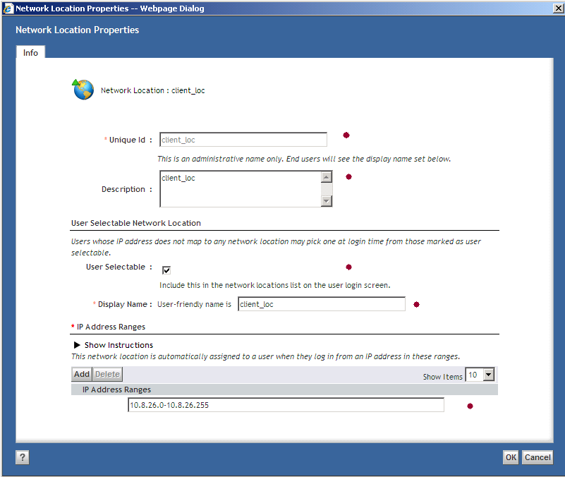
Configuration Steps
Using Documentum Administrator to finish configuration
Installation and Configuration Steps
Installation and Configuration Steps

Slide 32
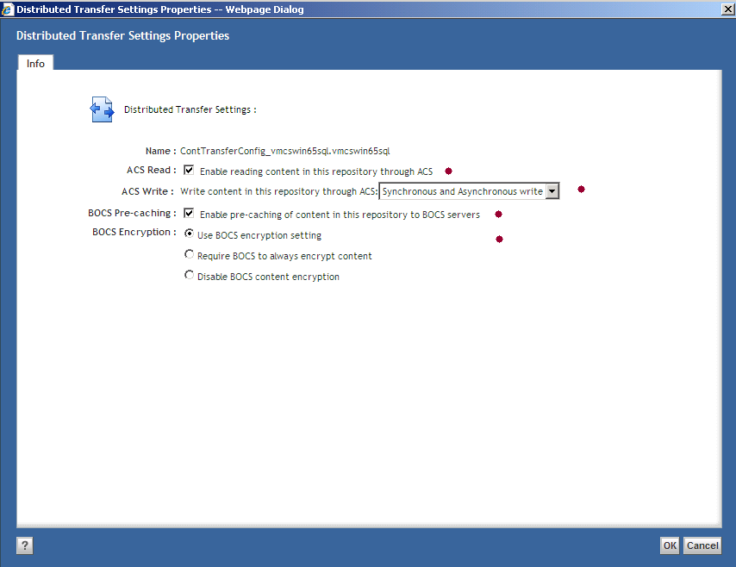
Configuration Steps
Using Documentum Administrator to finish configuration
Installation and Configuration Steps
Installation and Configuration Steps

Slide 33
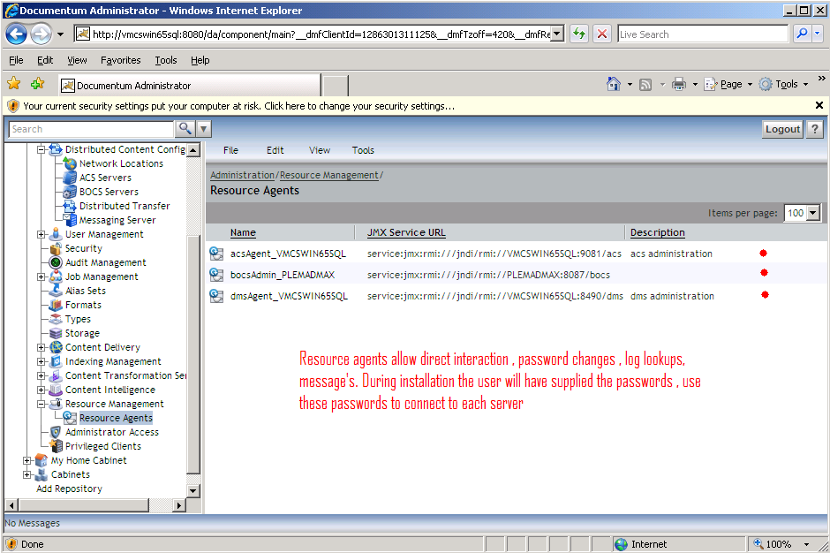
Configuration Steps
Using Documentum Administrator to finish configuration
Installation and Configuration Steps
Installation and Configuration Steps

Slide 34
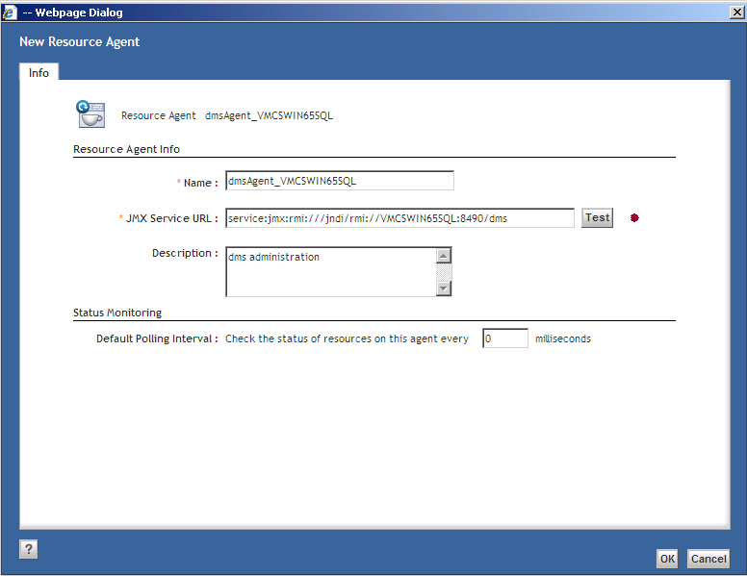
Configuration Steps
Using Documentum Administrator to finish configuration
Installation and Configuration Steps
Installation and Configuration Steps

Slide 35
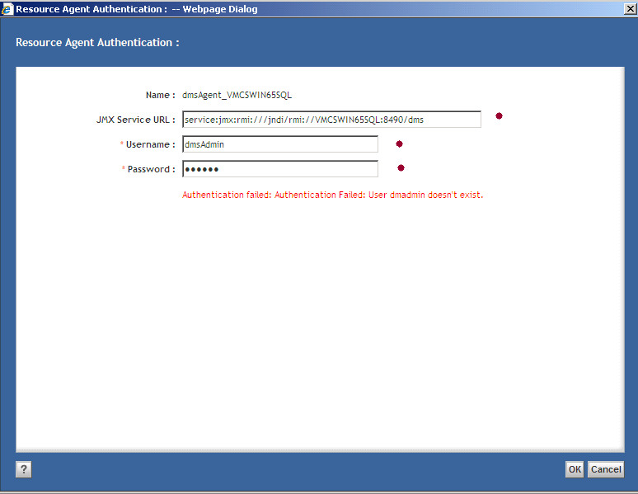
Configuration Steps
Using Documentum Administrator to finish configuration
Installation and Configuration Steps
Installation and Configuration Steps

Slide 36
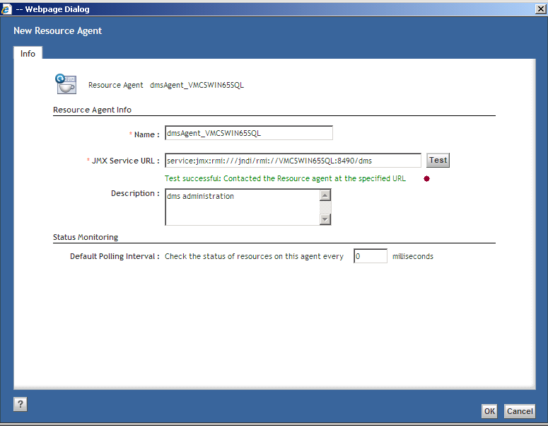
Configuration Steps
Using Documentum Administrator to finish configuration
Installation and Configuration Steps
Installation and Configuration Steps

Slide 37
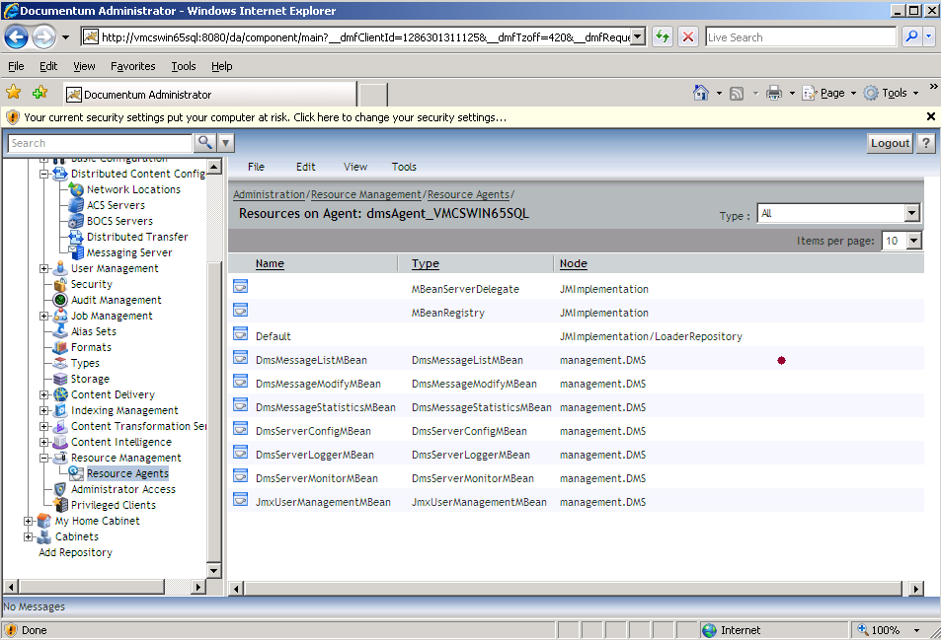
Configuration Steps
Using Documentum Administrator to finish configuration
Installation and Configuration Steps
Installation and Configuration Steps

Slide 38
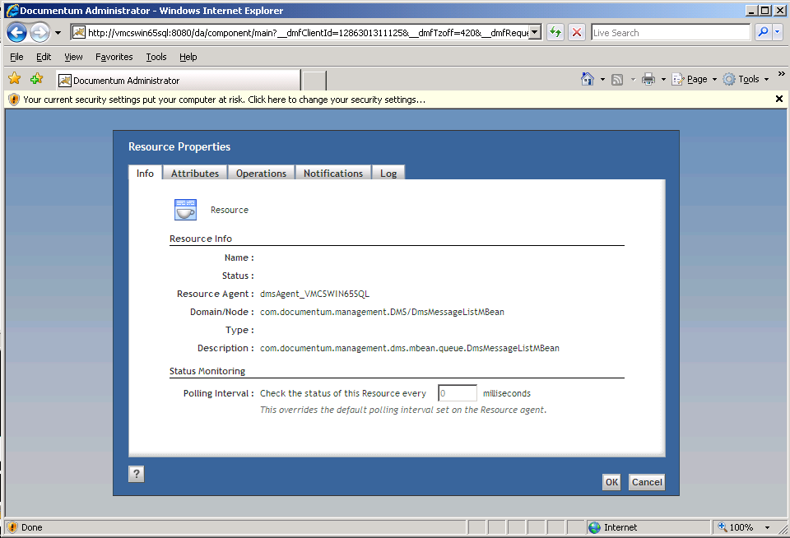
Configuration Steps
Using Documentum Administrator to finish configuration
Installation and Configuration Steps
Installation and Configuration Steps

Slide 39
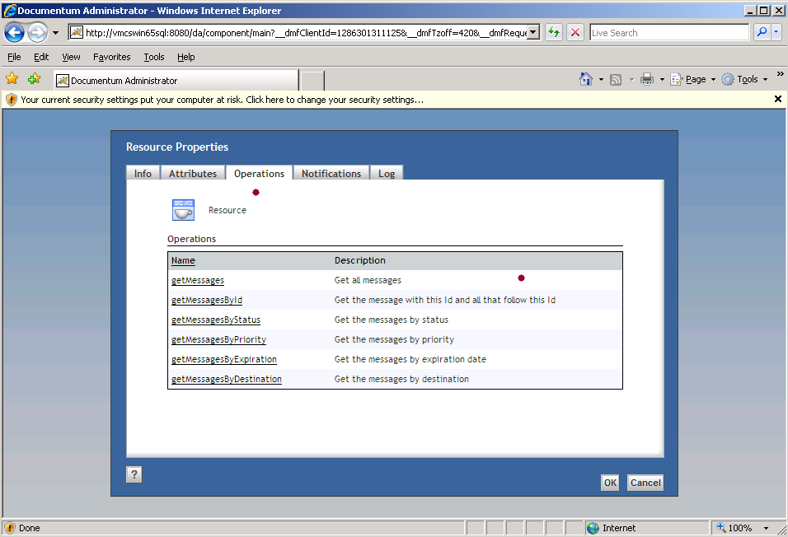
Configuration Steps
Using Documentum Administrator to finish configuration
Installation and Configuration Steps
Installation and Configuration Steps

Slide 40
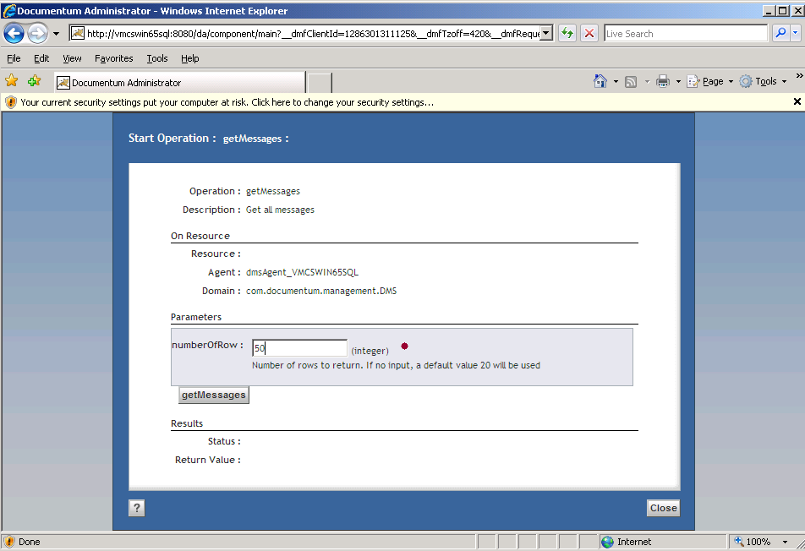
Installation and Configuration Steps

Slide 41
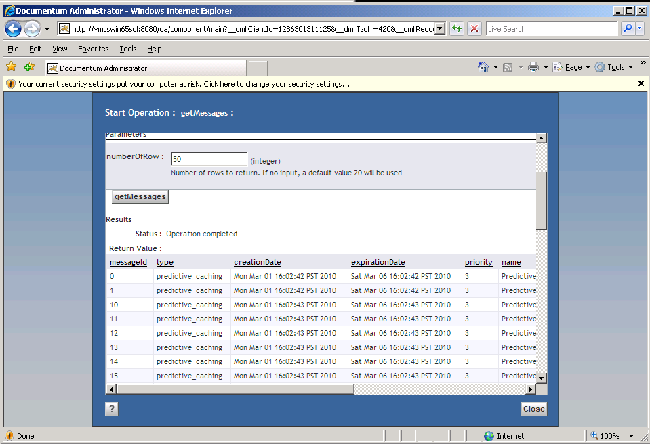
Installation and Configuration Steps

Slide 42
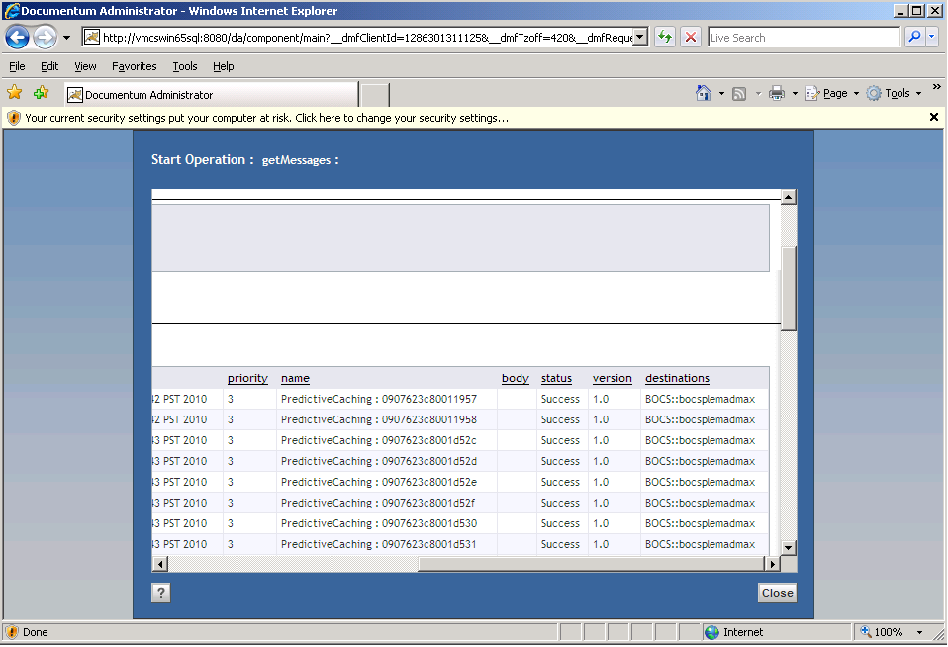
Installation and Configuration Steps

Slide 43
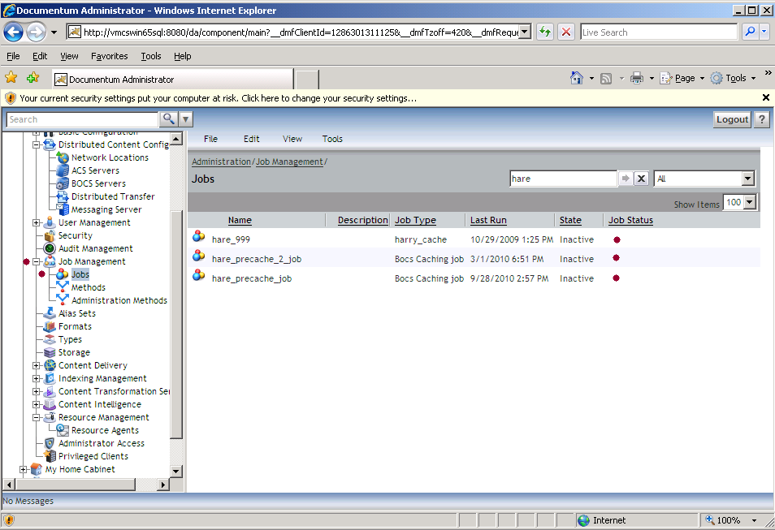
Installation and Configuration Steps
Pre Cache Jobs

Slide 44
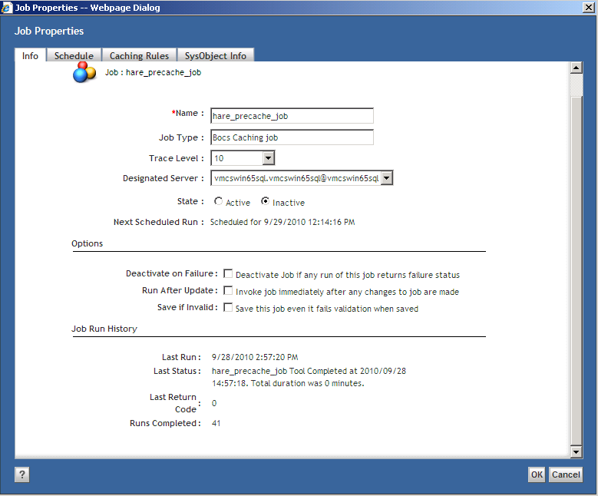
Installation and Configuration Steps
Pre Cache Jobs

Slide 45
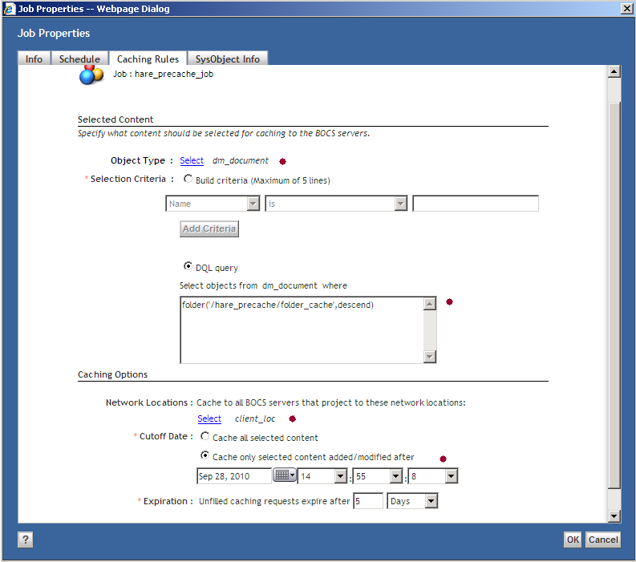
Installation and Configuration Steps
Pre Cache Jobs

Slide 46
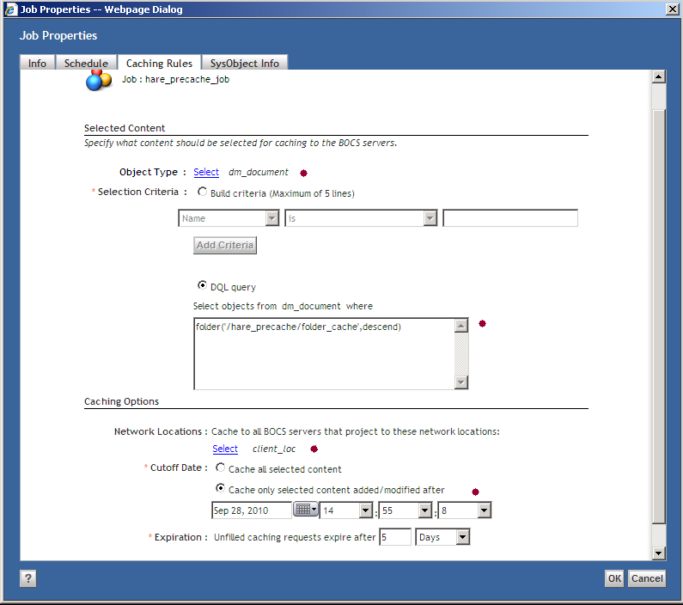
Installation and Configuration Steps
Pre Cache Jobs

Slide 47
Installation and Configuration Steps
Pre Cache Jobs --- Sample Job Report
hare_precache_job Report For DocBase vmcswin65sql.vmcswin65sql As Of 2010/09/28 14:56:57
---------------------------------------
Predicative Caching Job
This sends request to cache content on BOCS.
Job Arguments:
(StandardJobArgs: docbase_name=vmcswin65sql.vmcswin65sql userName=dmadmin jobId=0807623c8000992c methodTraceLevel=10)
query_type=dm_document
query_predicate=folder('/hare_precache/folder_cache',descend)
network_locations=client_loc
cutoff_time=03/05/2010 12:51:47
expiration=432000
batch_size=50
---------------------------------------
2010/09/28 14:57:03:796 Content selected for caching:
2010/09/28 14:57:04:921 Cache content for object 0907623c8001f52e at page 0
2010/09/28 14:57:05:140 Cache content for object 0907623c8001f52f at page 0
2010/09/28 14:57:05:156 Cache content for object 0907623c8001f530 at page 0
Report End 2010/09/28 14:57:18

Slide 48
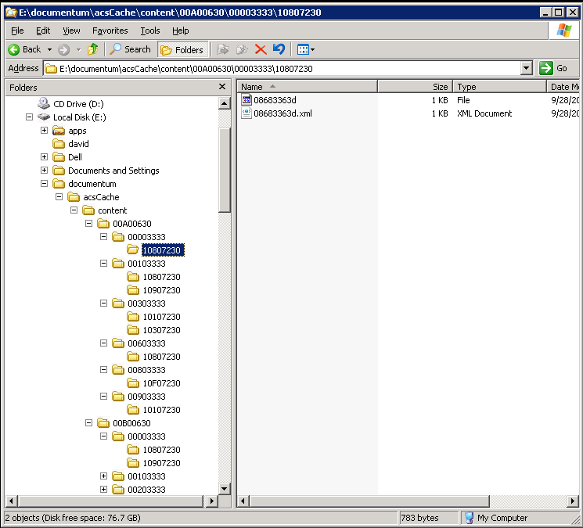
Installation and Configuration Steps

Slide 49
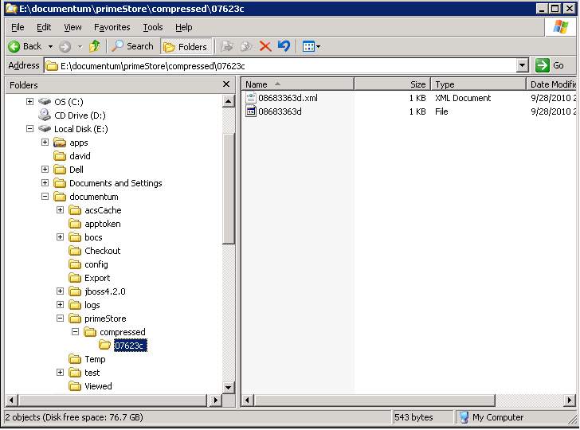
Installation and Configuration Steps
Content stays stored only when DMS server is down, Async job will move content into Docbase. Job should be marked active at times, may need to be launched manually to move content from primeStore.

Slide 50
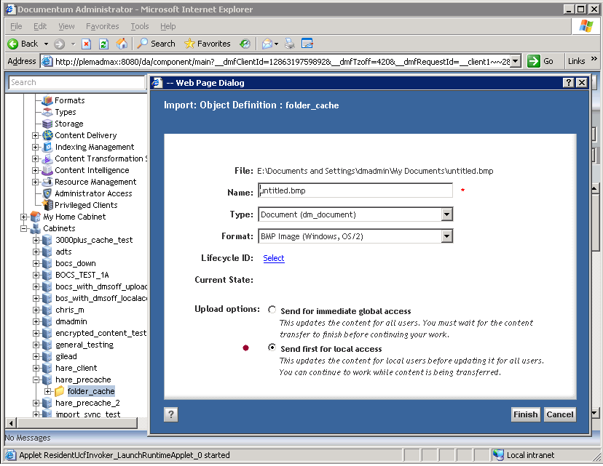
Installation and Configuration Steps

Slide 51
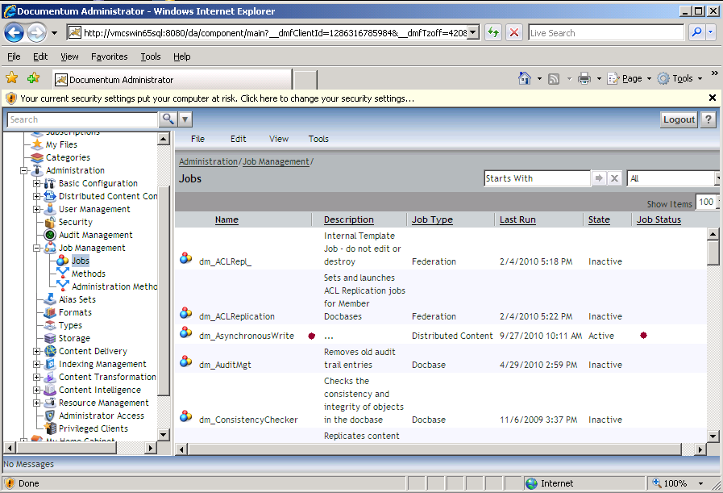
Installation and Configuration Steps

Slide 52
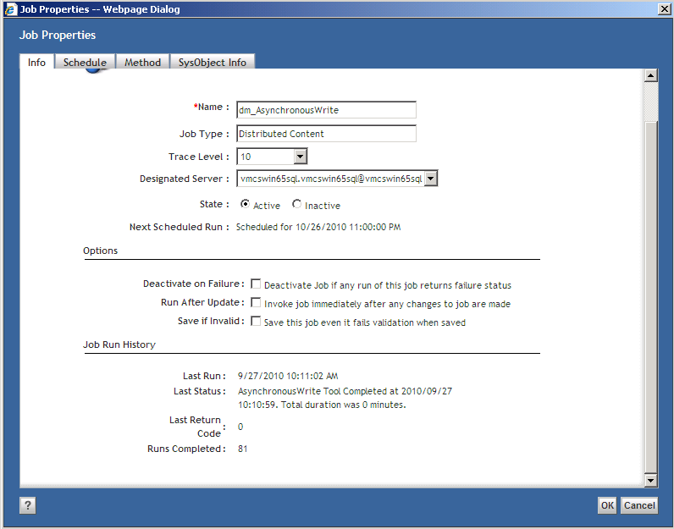
Installation and Configuration Steps

Slide 53
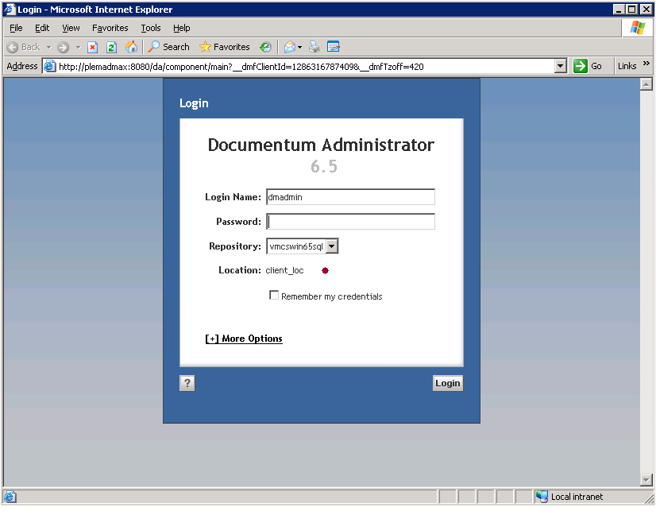
Installation and Configuration Steps
WDK App.xml Configuration

Slide 54
Installation and Configuration Steps
WDK App.xml Configuration
<!-- Begin {D6 accelerated content transfer (ACS) settings} -->
<!-- <accelerated-read> :
This is for accelerated Read, and it replaces the correpsonding 5.3.x <acs> configurations.
It allows accelerated read and write to be switched on and off separately.
For backward compatibility, WDK D6 first looks up the <acs> tag before looking up the
<accelerated-read> tag.
-->
<accelerated-read>
<!-- when set to be "true", enables ACS, and, when optimal, BOCS read operations -->
<enabled>true</enabled>
<!-- the followings are the existing options under the 5.3.x "acs" tag -->
<attemptsurrogateget>true</attemptsurrogateget>
<maintainvirtuallinks>true</maintainvirtuallinks>
</accelerated-read>

Slide 55
Installation and Configuration Steps
<!-- <accelerated-write> :
A separate configuration block for accelerated Write
-->
<accelerated-write>
<!-- when set to be "true", enables ACS, and, when optimal, BOCS write operations -->
<enabled>true</enabled>
<!-- when set to:
1. "prohibit-async" - application doesn't allow BOCS write asynchronously
2. "default-sync" - application should see content written from BOCS to ACS synchronously by default
3. "default-async" - application should see content written from BOCS to ACS asynchronously by default
-->
<bocs-write-mode>default-async</bocs-write-mode>
<!-- when set to "true", allows override of default BOCS write mode by users
(in general, it should be scoped with <filter> tag, e.g. role-based) -->
<allow-override-bocs-write-mode>true</allow-override-bocs-write-mode>
</accelerated-write>
<!-- End {D6 accelerated (ACS) content transfer settings} -->

Slide 56
Trouble Shooting.
What’s installed ?
Are all the services running ?
Configuration complete ?
Test the ACS, DMS, BOCS urls
App.xml configured ?
Test with import, checkout, precache job
Use resource agents to test account connectivity !
Check logs ACS, BOCS, DMS, turn on debug tracing if needed.

Slide 57
Conclusion
Using BOCS with the enterprise can dramatically improve content transfers.
Simplify overall administration, while allowing for production deployments by adding additional servers on the fly with minimal impact on the core products.
Down sizing a deployment is a easy as scaling the enterprise.
Your content can be just as secure as your main docbase content.
Pre emptive caching provides the administrator to anticipate future performance problems and allows a solution to be in place before a problem is even encountered ?

Slide 58
Questions ?
Questions ?
See Distributed_Content_Configuration_And_Troubleshooting for A-Z and excellent troubleshooting steps.

